Slide 1
Natural Language to SQL Conversion
Group 4
Muhammad Haseeb Ahmad (110123184)
Shivraj Mangaroliya (110124250)
Mohit Gadhiya (110124217)

Slide 2
Introduction
In today's tech world, businesses really need to manage data well. They use systems like RDBMS and SQL to get the data they need.
Not everyone is well-versed in SQL, creating a gap between tech-savvy and non-tech users in accessing valuable information from databases.
Introducing the Natural Language Interface to the Database System (NLIDB), a solution designed to bridge this gap by allowing users to communicate with databases using everyday English.
This innovative system transforms the complex process of querying databases into a simple conversation, making data extraction accessible to everyone, regardless of technical expertise.

Slide 3
Related Work
Text Mining
Text mining processes are information extraction, information retrieval, natural language processing, text classification, content analysis and text clustering.
NLTK – Natural Language toolkit
The effective use of NLTK for extraction of relevant information.
NLP to SQL
overall view of the usage of Natural Language Processing (NLP) and use of regular expressions to map the query in English language to SQL.
Python Open source Codes
Proposal for extension of Python library function as an open source.

Slide 4
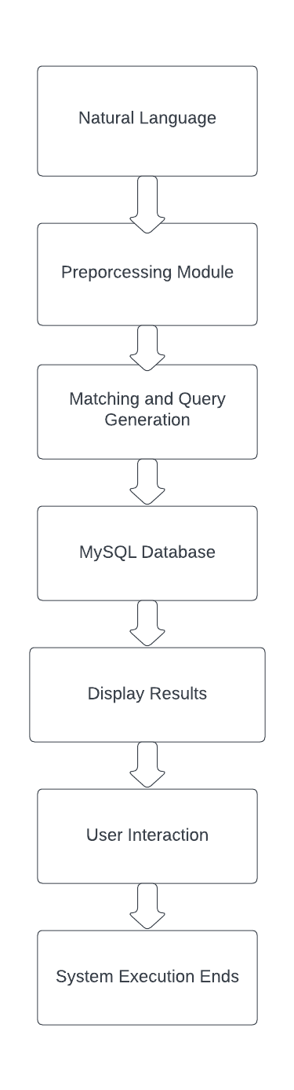
Proposed Model
User input as textual data
Text cleaning/ preprocessing
Query generation using NLTK library and with the use of rule based system.
Connection with MYSQL
Extracting data from DB
User interaction

Slide 5
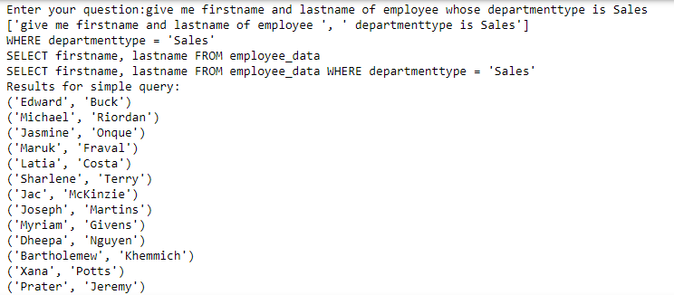
result

Slide 6
LIMITATION
Sometimes user can input small sentences. Those English statements are less informative to extract SQL query,
as an example who is Alice?
So basically system can not generate the SQL query for this sentence and can not provide information about Alice.

Slide 7
Conclusion
In conclusion, This project helps to those user who are not aware about database operations using SQL.
It have some limitations, which can be covered by in future by doing extensive research to make it well-versed.
NLP is a vast field which could be useful in this project to make database operations completely in natural language.

Slide 8
References
S. Vijayarani and R. Janani, "Text Mining: Open Source Tokenization Tools – An Analysis," Advanced Computational Intelligence: An International Journal (ACII), vol. 3, no. 1, pp. 37, Jan. 2016. DOI: 10.5121/acii.2016.3104. Accessed: Nov. 1, 2023.
S. Bird, "NLTK: The Natural Language Toolkit," Department of Computer Science and Software Engineering, University of Melbourne, Victoria 3010, Australia; Linguistic Data Consortium, University of Pennsylvania, Philadelphia, PA 19104-2653, USA.
Uma M, Sneha V, Sneha G, Bhuvana J, Bharathi B, "Formation of SQL from Natural Language Query using NLP”
https://dev.mysql.com/doc/connector-python/en/
https://www.nltk.org/
https://www.mygreatlearning.com/blog/tokenization/

Slide 9
THANK YOU

